Slide 1

GRUNet Model for Brain Tumor Detection in Medical Imaging using PyTorch

Slide 2
TEAM MEMBERS
01
Oluma Moses Oche
02
Amadi Chimeremma S.
Moses.oluma1@gmail.com
03
Nnadiekwe Chigozie A.

Slide 3
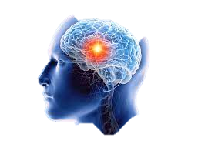
OBJECTIVE
Leveraging deep learning algorithms in the detection and diagnosis of brain tumors. This was achieved by analyzing medical images, such as Magnetic Resonance Imaging (MRI) or Computed Tomography (CT) scans

Slide 4
Description of Training Dataset
The image data for this project is Brain MRI Images.
Our model was trained on a large dataset of labeled brain tumor images to learn the patterns and features associated with different tumor types.
It consists of MRI scans of two classes:
No brain tumor(NO) - no tumor, encoded as 0
Brain tumor(YES) - tumor, encoded as 1
The No consists of 2087 images, while Yes consists of 2513 images
Total = 4,600

Slide 5
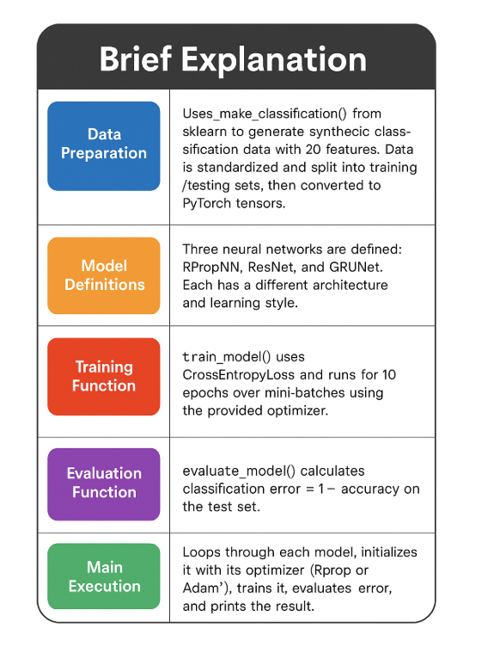

Slide 6
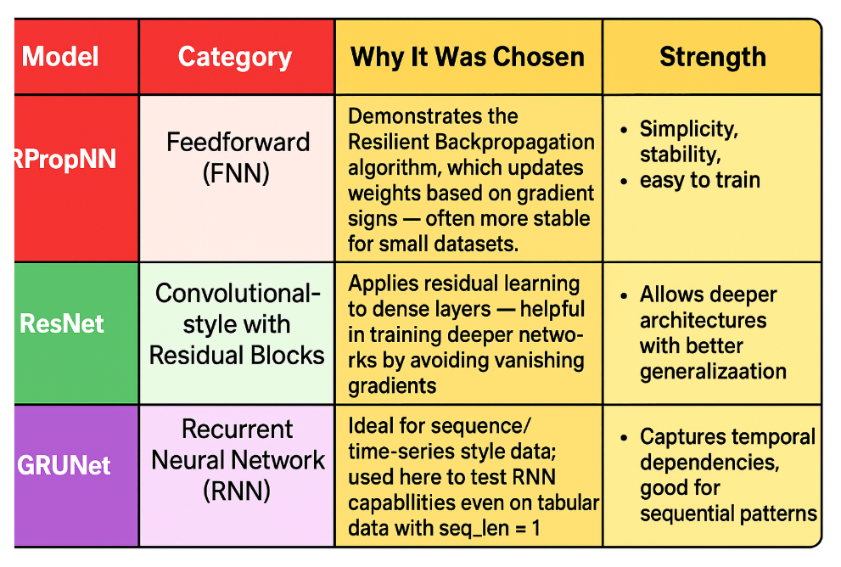
RPropSNN Feedforward Network:
Resilient Propagation-based Spiking Neural Network.
ResNet CNN
Residual Network-based Convolutional Neural Network.
GRUNet RNN
Gated Recurrent Unit Network-based Recurrent Neural Network

Slide 7
Error Evaluation of Models
RPropNN
Vs
ResNet
Vs
GRUNet
S/N | Model | Classification Error
1 | RPropNN | 0.1500
2 | ResNet | 0.1750
3 | GRUNet | 0.1300
GRUNet has the lowest classification error (13%), meaning it performed best in correctly classifying the test data.

Slide 8
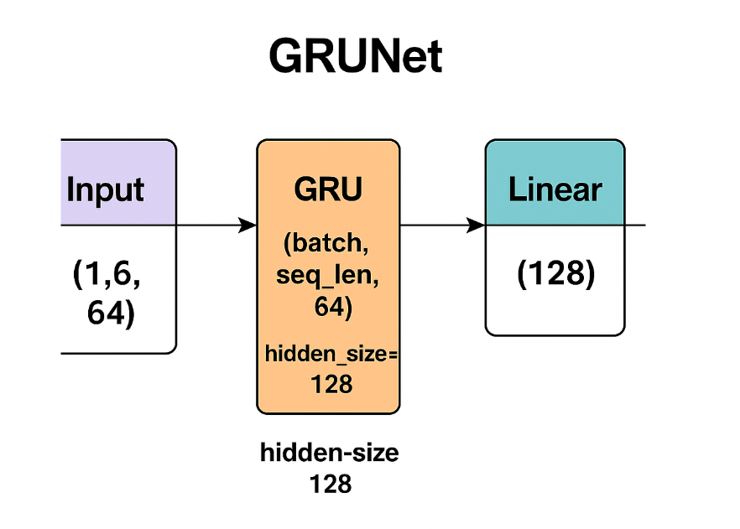
GRUNet Model Architecture

Slide 9
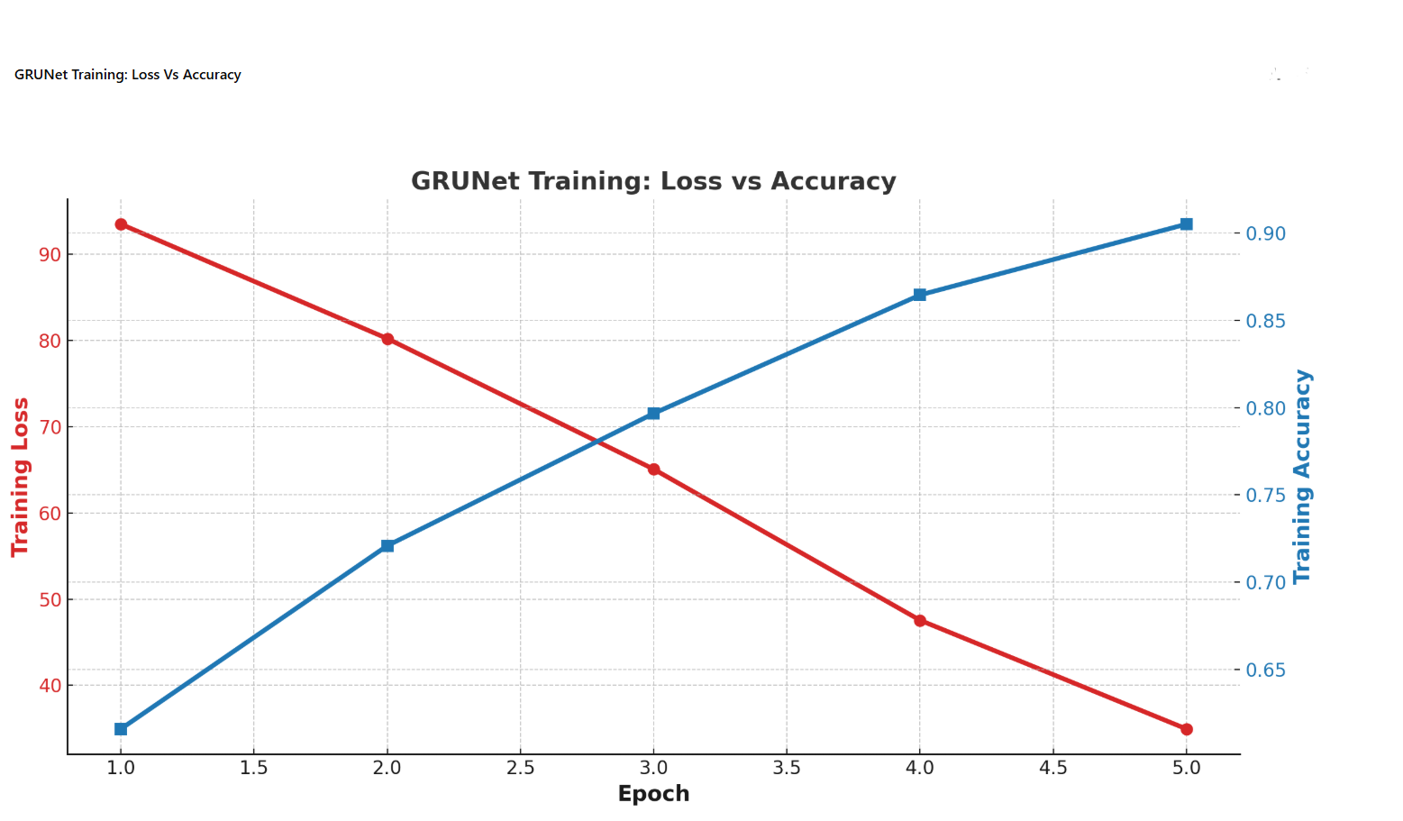
Over 5 training epochs, the accuracy was achieved at over 90%. The training loss below 20%.

Slide 10
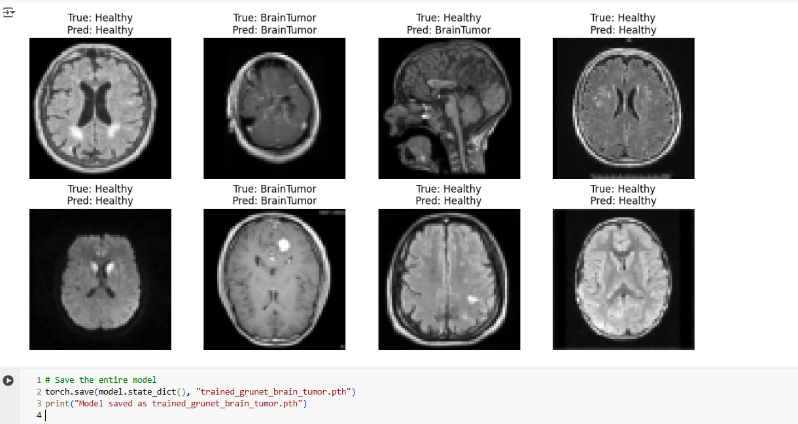
MODEL ACCURATELY PREDICTED

Slide 11
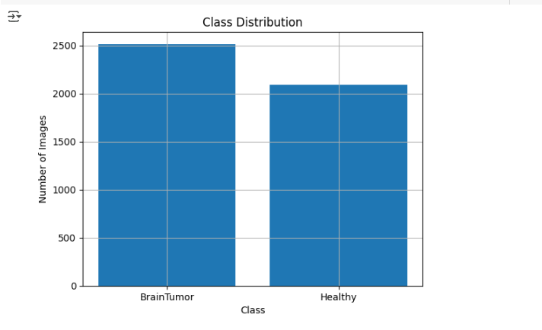
RESULTS

Slide 12
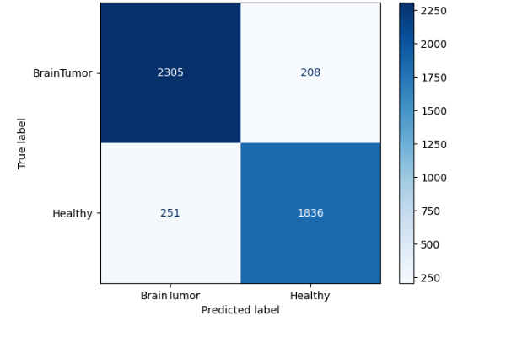
CONFUSION MATRIX
This confusion matrix shows that out of the true Brain Tumor cases, 2305 were correctly predicted while 208 were misclassified as Healthy.
For true Healthy cases, 1836 were correctly identified, and 251 were incorrectly labeled as Brain Tumor.

Slide 13
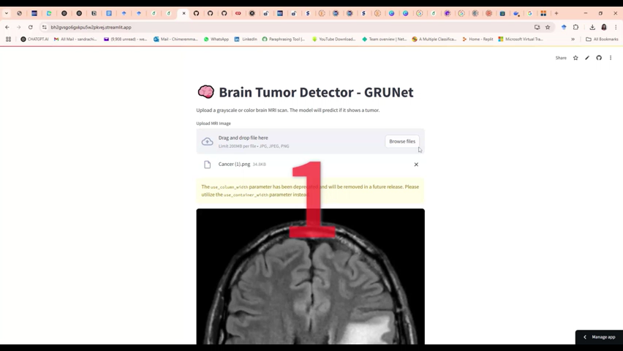
Video Demo

Slide 14
Conclusion
In conclusion, this project demonstrated the accuracy of brain tumor detection and classification using Deep Learning, offering a valuable support tool for healthcare professionals in neuro-oncology.
By improving diagnostic precision and efficiency, the proposed approach (GRUNet) contributes to more timely and effective treatment planning, ultimately aiming to improve patient outcomes.
Resources
Online Application - https://bh2gvsgo6gxkpu5w2pkvej.streamlit.app/

Slide 15

THANK YOU Q AND A

